Slide 1
Last of the Design Patterns That I am presenting

Slide 2
Part 05: Modularity Part 1: Bridge Pattern
Essentially make an API that seperates system calls from game code.

Slide 3

Modularity Example: Logging
A game might need multiple implementations and need to switch between them to:
match hardware (e.g. read from a controller vs keyboard and mouse)
match the platform (e.g. different filesystem APIs (iOS vs Android)
improve performance (e.g. replace 3D audio with 2D)
aid in debugging (e.g. show all errors in debug mode, log to a file in release)
Game logic should not know about any of this!

Slide 4
Modularity
Example 1:
Switch behaviours at runtime based on game or player preference
Example: Error logging or switching input mappings (don’t tell Bethesda*)
Example 2:
Quarantine platform-specific details without affecting the rest of the code
Example: High-score table
* I installed Fallout 4 3 times because I thought it was broken when it didn’t read from the keyboard… turns out the keyboard is ignored if there is a controller present… mostly.

Slide 5
Logging Service Example
But when doing a demo, this would look bad! Instead, errors quietly go to a log file:
var enemies = LoadDefinitions(“enemy”);
if (enemies.count == 0) { #if unreal_editor UIManager.ShowError(“Failed to Load!!!"); #else TextLogger.LogError(“Failed to Load!”); }
We want alerts during development if something doesn’t look right:
var enemies = LoadDefinitions(“enemy”);
if (enemies.count == 0) { UIManager.ShowError("Enemies failed to Load!!!");
}
This is ugly. Game code should neither know nor care.

Slide 6
A better logging service: Development
At initialization:
Logger.instance = new ErrorDialogLogger(“c:\log.txt”);
In game code:
var enemies = LoadDefinitions(“enemy”); if (enemies.count == 0) { Logger.instance.LogError(“Failed to load!”); }
Abstract class Logger
Static ILogger instance;
Abstract void LogError(string)
TextFileLogger
void LogError(string)
ErrorDialogLogger
void LogError(string)
Write to text file
Display a popup

Slide 7
A better logging service: Demo
Abstract class Logger
Static ILogger instance;
Abstract void LogError(string)
At initialization:
Logger.instance = new TextFileLogger(“c:\log.txt”);
In game code:
var enemies = LoadDefinitions(“enemy”); if (enemies.count == 0) { Logger.instance.LogError(“Failed to load!”); }
TextFileLogger
void LogError(string)
ErrorDialogLogger
void LogError(string)
Write to text file
Display a popup

Slide 8
A better logging service: In practice
At initialization:
If (Debug.isDebugBuild){ Logger.instance = new ErrorDialogLogger(logFile); } else { Logger.instance = new TextFileLogger(logFile); }
var enemies = LoadDefinitions(“enemy”); if (enemies.count == 0) { Logger.instance.LogError(“Failed to load!”); }

Slide 9
Variation on the theme 01
abstract public class Logger { private static Logger _instance;
public static Logger getInstance () {
if (_instance == null) {
_instance = newTextFileLog("c:\log.txt");
}
return _instance;
}
}
Game Code:
Logger.getInstance().LogError(“blah!”);
Problem: How do we initialize this service?
Option 01: Singleton - initialize itself
Very convenient (“pay for what you use”)
What if we want to switch implementations?

Slide 10
Variation on the theme 02
abstract public class Logger { public static Logger instance; public void LogError (string text);
Initialization Code:
Logger.instance = new TextFileLogger(“C:\log.txt”);
//For the love of stroustroup don't hardcode
//your filepaths! Game Code:
Logger.instance.LogError(“blah”);
Problem: How do we initialize this service?
Option 01: Singleton - initialize itself Option 02: Static Service Locator*
Better! Now we control implementation
Needs an initialization call
*Or maybe this is an anti-pattern: https://blog.ploeh.dk/2010/02/03/ServiceLocatorisanAnti-Pattern/

Slide 11
Variation on the
theme 03
public class Services { public static Logger logger;
public static void InitializeServices() { Logger = new TextFileLogger(...); }
public static void InitializeServicesDebug() { Logger = new ErrorDialogLogger(); }
Initialization Code:
ServiceLocator.InitializeServices();
Game Code:
Services.logger.LogError(“blah”);
Problem: How do we initialize this service?
Option 01: Singleton - initialize itself Option 02: Static Service Locator Option 03: “God object” service locator
Groups entire families of services
Notes:
For the love of Stalman don’t hard code your file paths either.

Slide 12
punchline
Essentially we don't want game code to be concerned with meta stuff or maintenance
Our game engines handle a LOT of this for us.
Use a 'bridge' pattern to decouple services from the game code

Slide 13
Finite State Machines

Slide 14
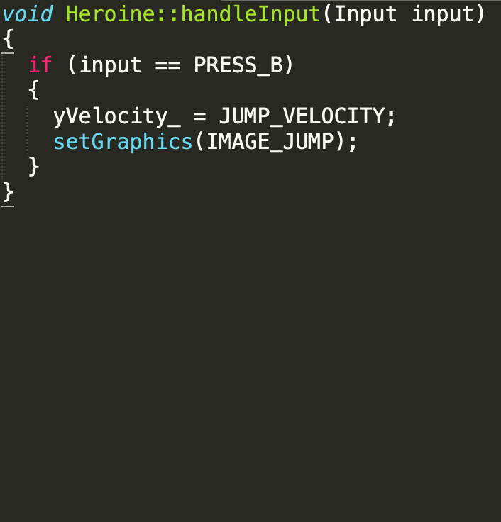
Spot the Bug
void Heroine::handleInput(Input input) { if (input == PRESS_B) { yVelocity_ = JUMP_VELOCITY; setGraphics(IMAGE_JUMP); } }
What is the issue here?

Slide 15
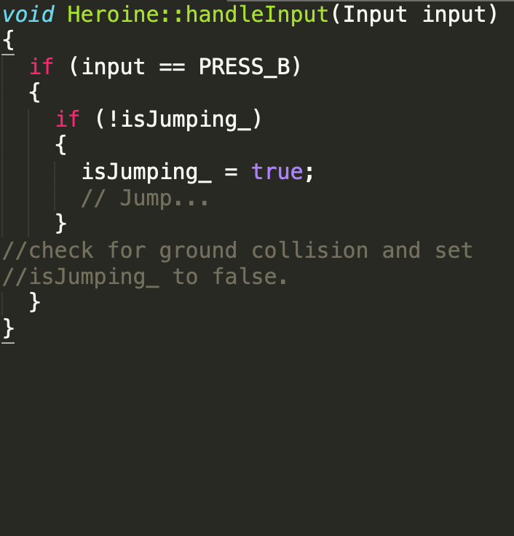
We can write an IF to check for this...
Add an 'isJumping_' flag and we get:

Slide 16
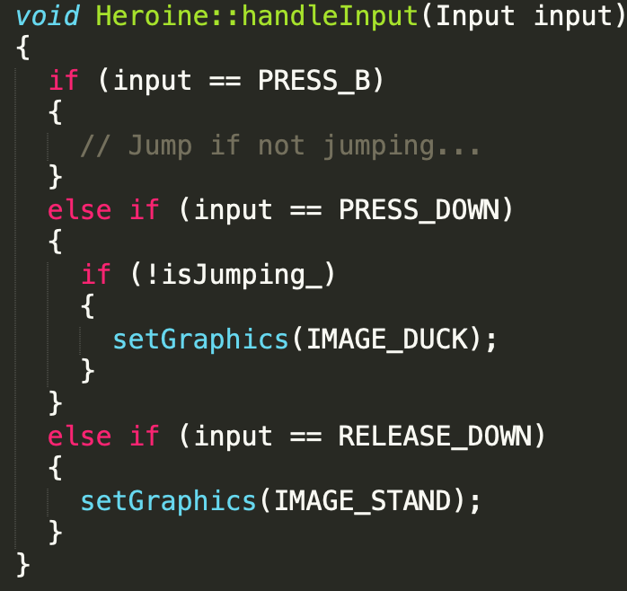
Spot the Bug
void Heroine::handleInput(Input input) { if (input == PRESS_B) { // Jump if not jumping... } else if (input == PRESS_DOWN) { if (!isJumping_) { setGraphics(IMAGE_DUCK); } } else if (input == RELEASE_DOWN) { setGraphics(IMAGE_STAND); } }
Now we want to duck...

Slide 17
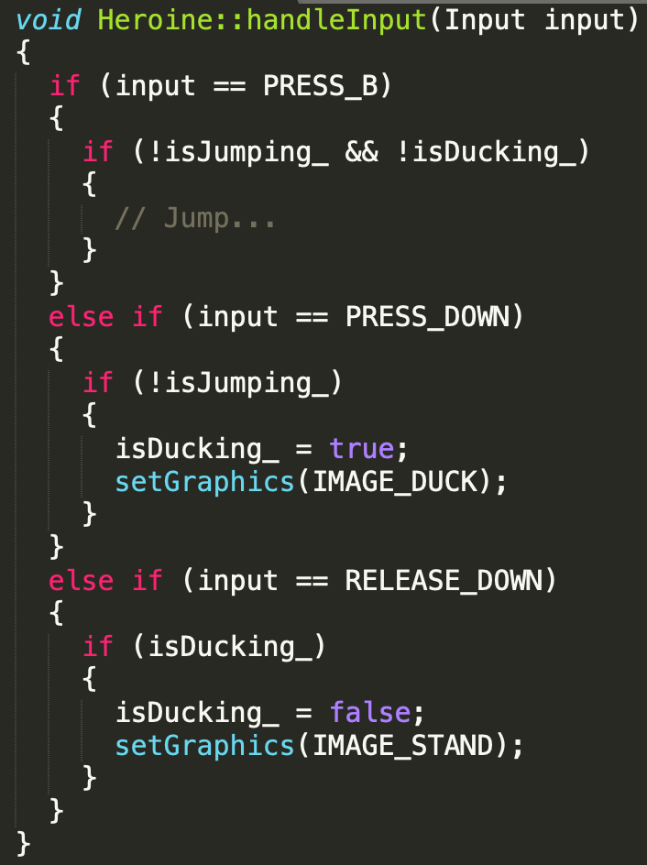
We can write an IF to check for this...
Add an 'isDucking_' flag and we get:

Slide 18

Something new
Now suppose we want to add in a dive attack.
Press down on the D-pad while airborn to perform a dive attack…
That's my jam!

Slide 19
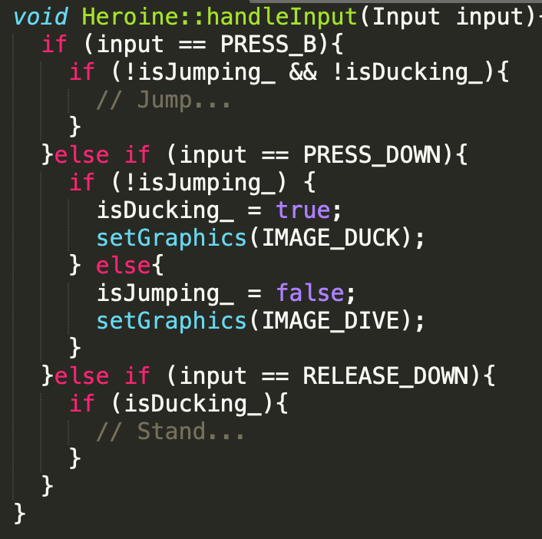


Slide 20
How would you diagram: standing, jumping, ducking, and a dive attack?
standing, jumping, ducking, and diving. When she can respond to a button press in one of those states, you draw an arrow from that box, label it with that button, and connect it to the state she changes to.

Slide 21
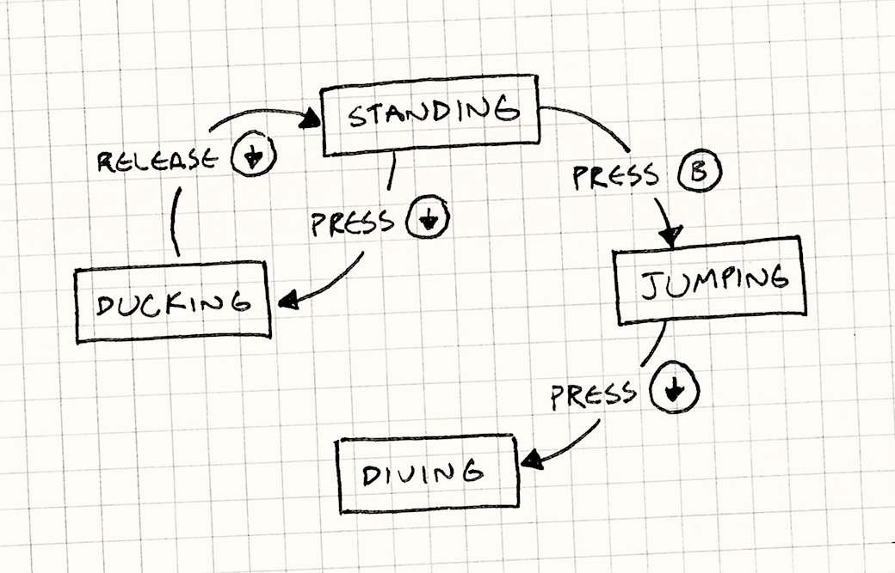
FSM
Finite STATE machine
Turing machines and others
Fixed set of states
Can only be in one state at a time
Inputs or events transition from one state to the next state

Slide 22
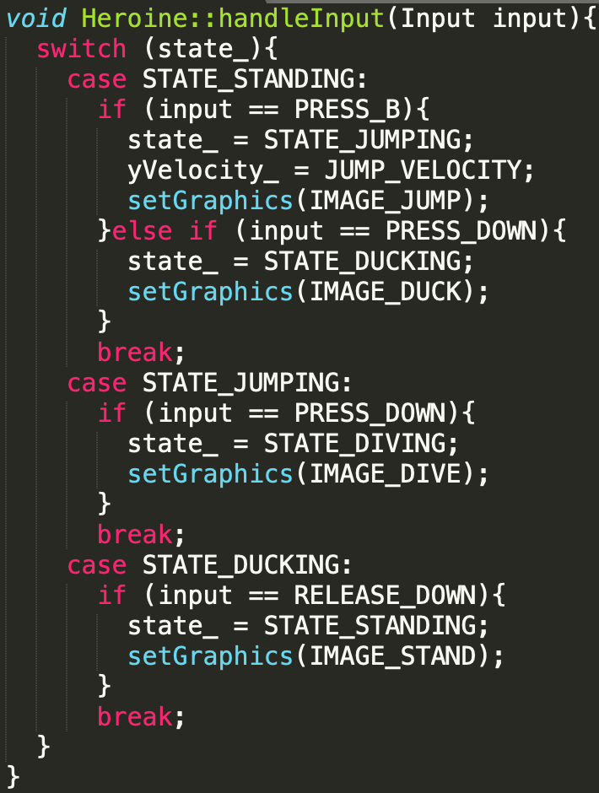
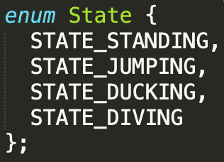
enum && switch
enum State {
STATE_STANDING, STATE_JUMPING, STATE_DUCKING, STATE_DIVING };
This might not seem like a huge change, HOWEVER
We now only have a single field for mutable state
We also combined all of our states into discrete parts.
However this isn't 100% perfect. If it gets much more complicated we need something else.

Slide 23
State Pattern
Encapsulate functionality in interchangeable objects that share the same interface
Switch objects at runtime, to make it look like system’s behaviour changes
Either a single “currently active” state
Or maybe a stack of states
This pattern shows up everywhere
If you’re doing a lot of ‘if-then’ checks based on game state, this is the pattern for you!

Slide 24
State
Allow an object to alter its behaviour when its internal state changes
The object will appear to change its class.

Slide 25

State Pattern: Input Handlers
IInputHandler
Walking Handler
Flying Handler
Swimming Handler
Standard Controls
Standard controls + invert up/down
Sluggish controls + move up/down under water
IInputhandler currentHandler

Slide 26
High Score Example
We have platform dependent parts of the game
Example: posting high scores to a leaderboard
iOS, Android -- provided by the OS
Windows -- requires 3rd party SDK such as Steam, Origin, Uplay, Etc.
BAD IDEA:
int score = DoSomeCalculations() {
#ifdef IOS_BUILD IOSService.PostScore(board, score); #endif
#ifdef WINDOWS_BUILD InitializeSteamLibrary(); SteamService.PosrtScore(score); #endif
This is ugly. Game code should neither know nor care.

Slide 27
High Score Example
Pattern: “Bridge”
Solution
We use the state pattern for actual functionality
A parent service contains and hides one of those implementations
void PostHighScore(){
int score = DoSomeCalculations(); HighScoreManager.instance.PostScore(score); }
HighScoreManager
Void PostScore(int)
Private IHighScore impl;
Interface IHighScore
Void PostScore(int)
SteamHighScoreImpl
iOSHighScoreImpl
Void PostScore(int)
Void PostScore(int)
(initialize Steam SDK)
(call SDK)
(Call the iOS SDK)

Slide 28
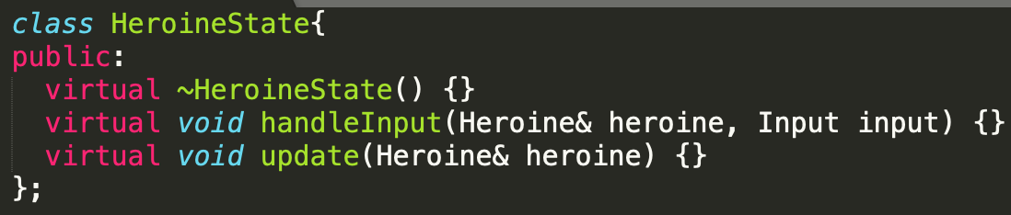
Interfaces… interfaces everywhere
For each switch we get a virtual method in an interface.

Slide 29
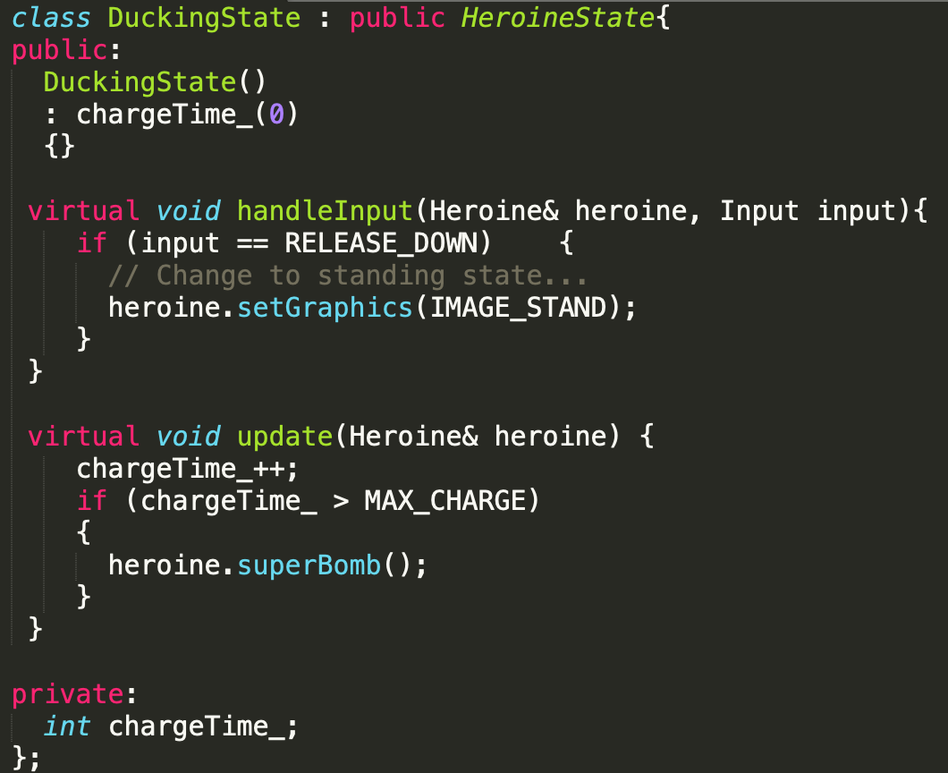
Classes for each state
For each state we define a class that implements the interface.
The methods of each class define the behaviour when in that state.
Take each case from the switch statement we saw before and move them to their state's class.

Slide 30
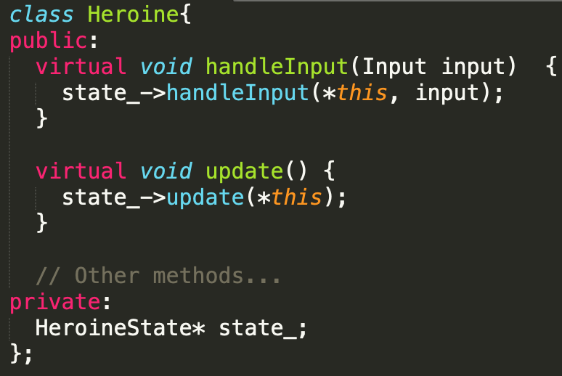
Pointing fingers
Now the Heroine has a pointer to her current state.
To 'change state' we assign state_ to point to a different HeroineState object
class Heroine{ public: virtual void handleInput(Input input) { state_->handleInput(*this, input); } virtual void update() { state_->update(*this); } // Other methods... private: HeroineState* state_; };

Slide 31
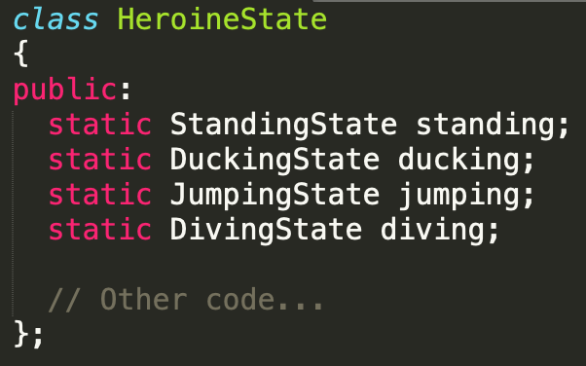
Static states
Since most of these don't have any internal variables we can use the same ones over and over.
This requires a bit of extra work…
I will leave that up to you to read about BOOO!!!!
class HeroineState { public: static StandingState standing; static DuckingState ducking; static JumpingState jumping; static DivingState diving; // Other code... };

Slide 32
Question
What happens if we add in more behaviours?

Slide 33
Lots of similar states
Hierarchical State Machines
Essentially define a 'super state'
OnGroundState
And substates inherit from onGroundState. If the child state can't handle the input, roll it up to the parent.
OnGroundState::handleInput(heronie, input)
Standing, walking, running, sliding, or ducking.
We can jump in all of them.
In all of them we are on the ground.
So we have a parent state: onGroundState.
class DuckingState : Public OnGroundState

Slide 34
An incomplete solution
Suppose we want to add in a weapon?
We could define more hierarchies…
The issue is FSMs have no idea of history. So if we go from standing, to shooting, to standing, the FSM has no idea how to handle that.

Slide 35
Stacks all the way down
Pushdown Automata
Essentially each state gets pushed onto a stack.
The current state is on top. Pop it, and we have a new state.
This works well for the shooting state.
Stand -> Shoot -> Stand

Slide 36
Stacks all the way down
Pushdown Automata
Essentially each state gets pushed onto a stack.
The current state is on the top. Pop it, and we have a new state.
This works well for the shooting state.
Stand -> Shoot -> Stand

Slide 37
Stacks all the way down
Pushdown Automata
Essentially each state gets pushed onto a stack.
The current state is on the top. Pop it, and we have a new state.
This works well for the shooting state.
Stand -> Shoot -> Stand

Slide 38
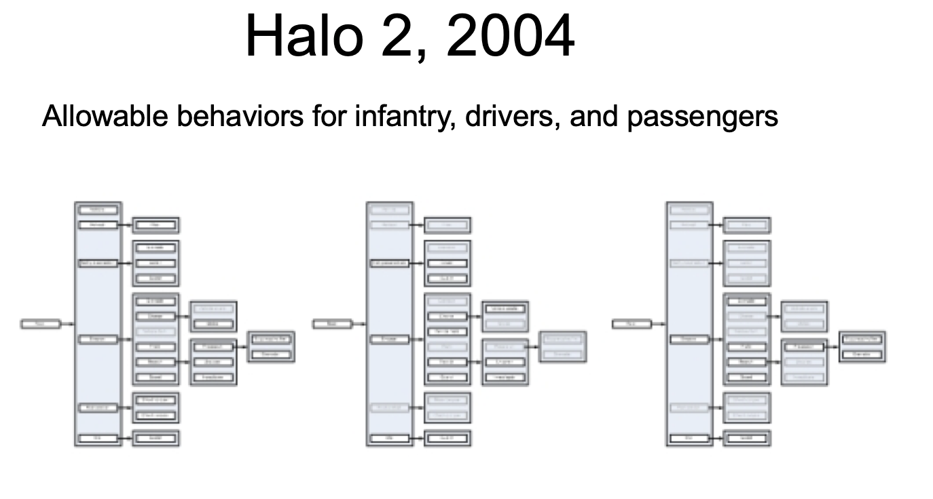
FSMs in use

Slide 39
Further Study
Bridge Pattern - Hides different behavioral States inside it
Goal Oriented Action Planning I highly suggest downloading either the paper, or the slides (preferably both) and reading them…
Behaviour Trees

Slide 40

Part 05: Modularity Summary
State Pattern - Encapsulate different variants into classes
Game code doesn’t have to know which platform it’s running on, etc
No if/else or #ifdefs!
Donald Knuth approves

Slide 41
Overall Review
UI game state stacks, model-view-controller
Data Layout shared read-only config data, externalized saved data
Communication event callbacks, global event bus
Behaviour command queues, strategy objects
Modularity state pattern, hiding implementation details
– Decouple dependencies between game systems – Make it easier to mix and match behaviour – Speed up development and iteration

